Slide 1

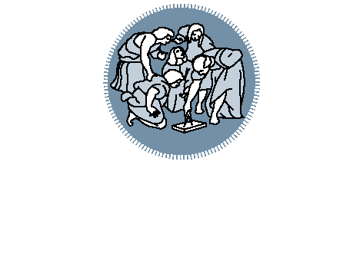
Titolo presentazione sottotitolo
Analysis and computation of DV and CV-QKD information rates
Milano, XX mese 20XX
Project for the Information Theory course of Professor M. Magarini
Gabriele Lecce, Roberto Scardia

Slide 2
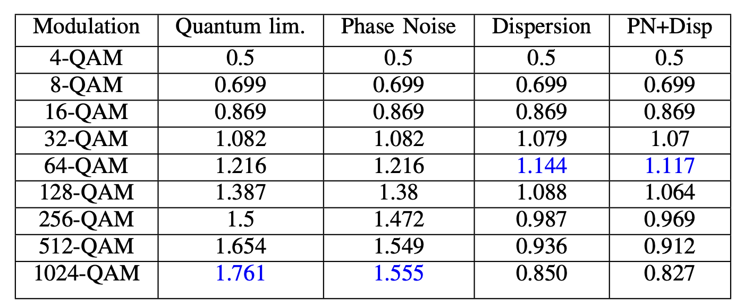
Table of contents
Channel models of DV-QKD protocols without eavesdropping
Channel models of DV-QKD protocols in case of intercept-resend attacks
CV-QKD quantum limited information rate
CV-QKD simulation with phase noise
CV-QKD simulation with dispersion
CV-QKD simulation with dispersion + phase noise

Slide 3
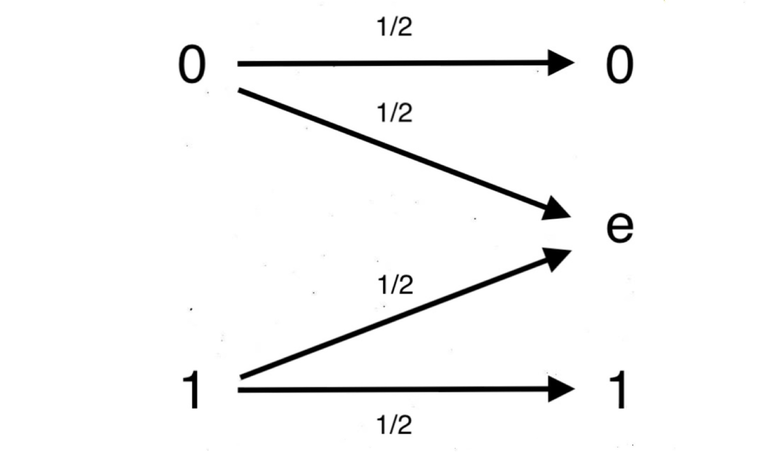
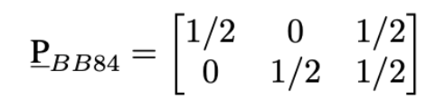
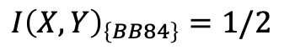
BB84 channel model (without eavesdropping)
One of the most important applications of quantum information theory and cryptography is Quantum Key Distribution: a secret key is exchanged through a quantum communication
channel using quantum states, and then it can be used as a one-time pad key in a cryptosystem. We can use the tools of information theory to construct channel models for QKD protocols:
Probability matrix:
Capacity:
$$I{\left(X,Y\right)}_{\left\{BB84\right\}}=1/2$$
BB84 channel model

Slide 4
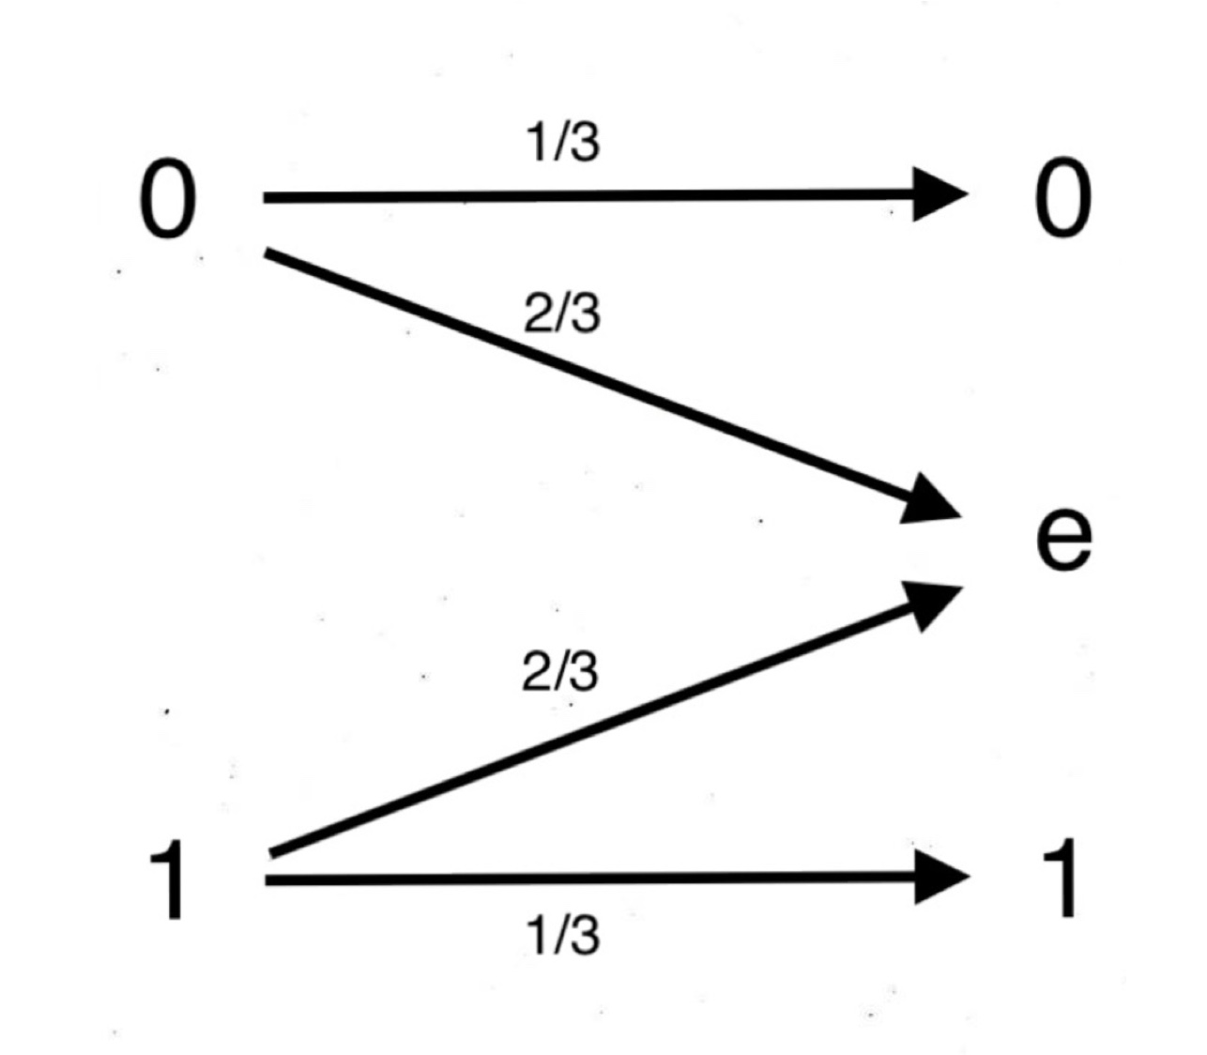
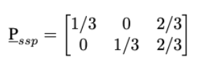
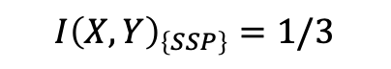
SSP channel model (without eavesdropping)
We receive, on average, 1 bit for the secret key every 3 channel uses, which is worse than the BB84 protocol. However, the SSP is more resilient against eavesdropping.
Probability matrix:
Capacity:
$$I{\left(X,Y\right)}_{\left\{SSP\right\}}=1/3$$
SSP channel model

Slide 5
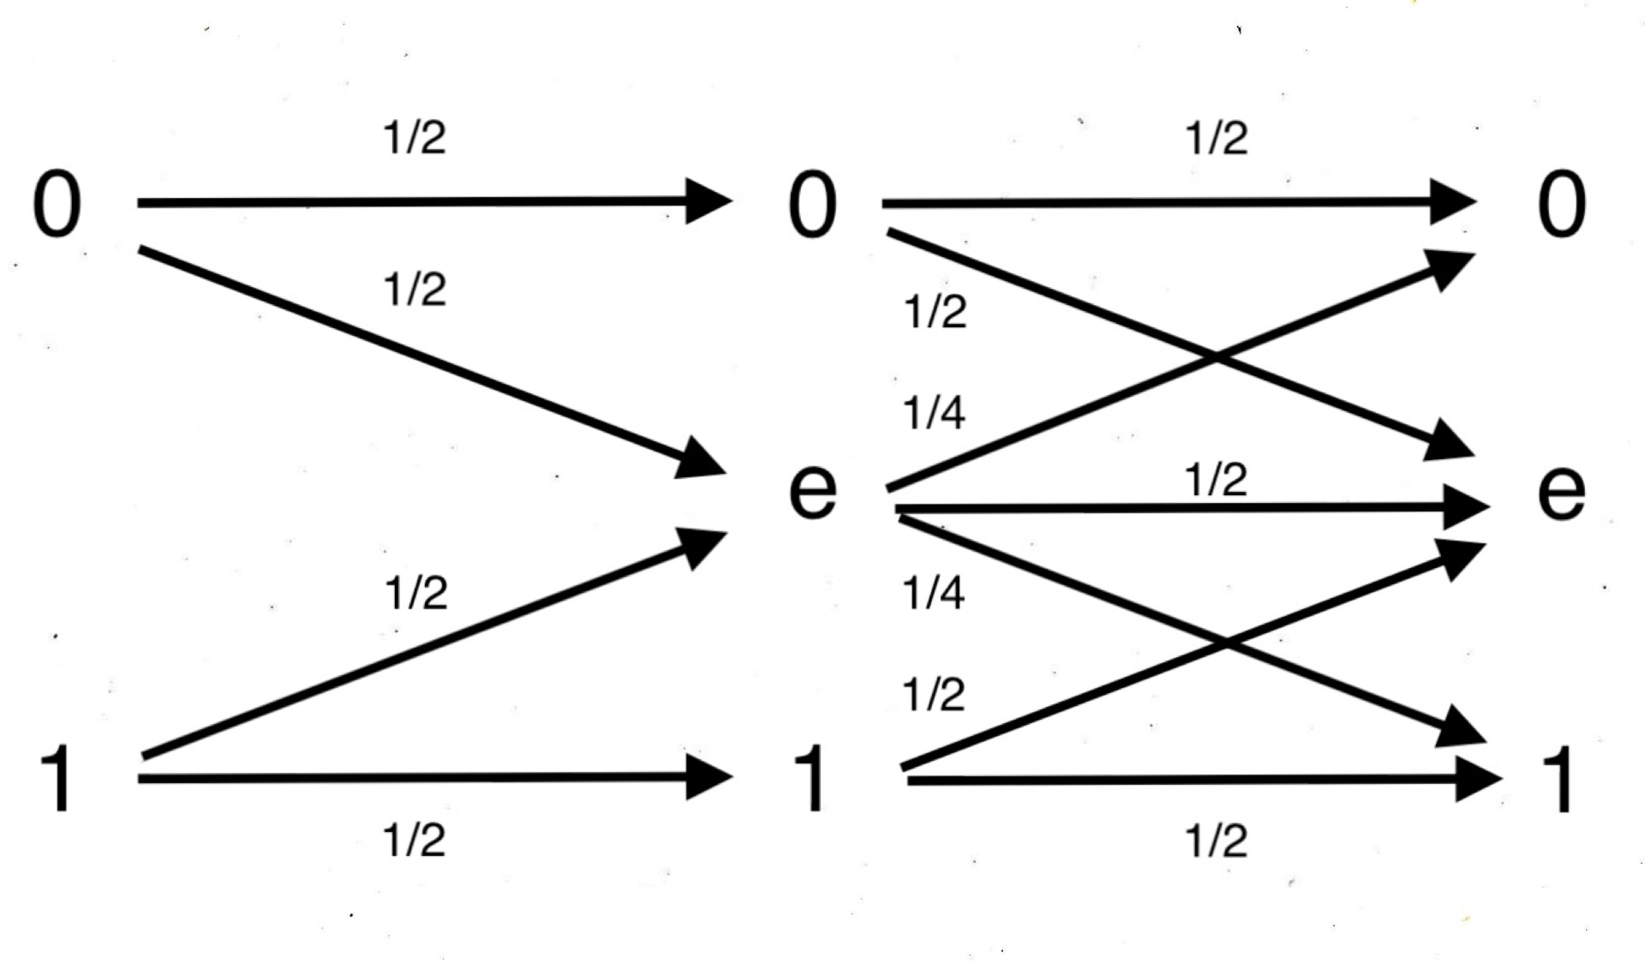
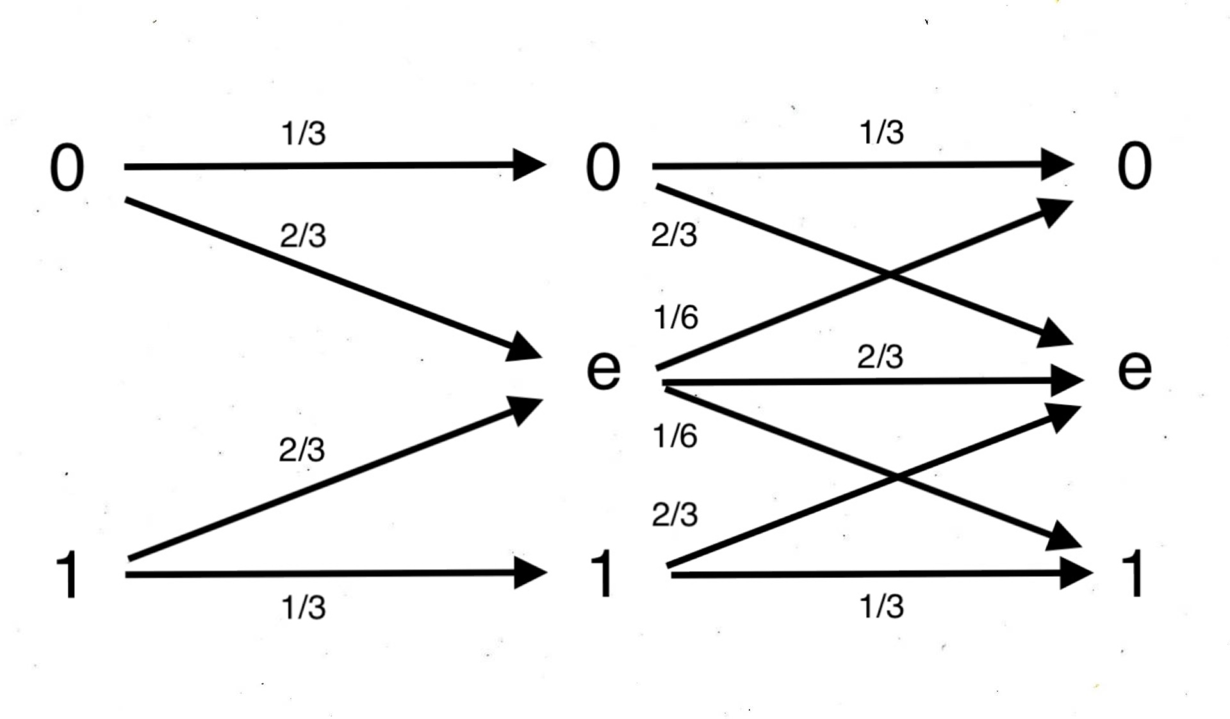
BB84 and SSP channel models (intercept-resend attack)
Ideally, the sifted keys obtained by Alice and Bob should be the same, but in a real case scenario we also have to consider the presence of an eavesdropper (Eve) and its effect on the channel capacity. In case of the intercept-resend attack we construct the following channel models:
BB84 channel model (with eavesdropping)
SSP channel model (with eavesdropping)

Slide 6
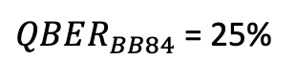
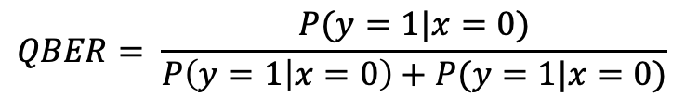
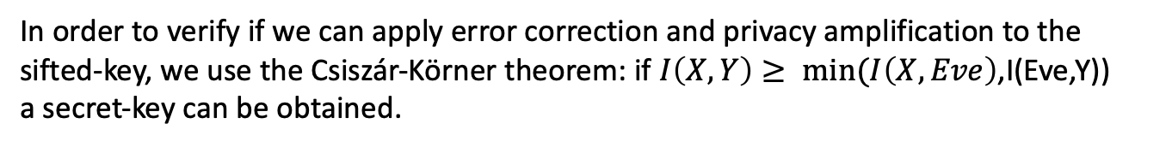
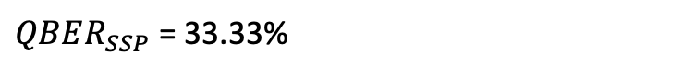
BB84 and SSP QBER
From the previous channel models we can calculate a quantity called Quantum Bit Error Rate (QBER), which is defined as the number of the wrong (flipped) bits of the sifted key over the length of the sifted key:
$QBER_{BB84}$ = 25%
$$QBER= \frac{P(y=1|x=0)}{P\left(y=1 | x=0\right)+P(y=1|x=0)}$$
$QBER_{SSP}$ = 33.33%
In order to verify if we can apply error correction and privacy amplification to the sifted-key, we use the Csiszár-Körner theorem: if $I\left(X,Y\right)≥ min(I\left(X,Eve\right)$,I(Eve,Y))
a secret-key can be obtained.
$$I{\left(X,Y\right)}_{EVE}⋅μ+ I{\left(X,Y\right)}_{NO EVE}⋅\left(1−μ\right)≥I\left(EVE,Y\right)$$
Where $μ$is a coefficient that indicate of how much Eve can interfere before tampering the key.

Slide 7
Maximum QBER for error correction and privacy amplification
For the BB84 case:
$$μ_{BB84}≤0.6161 →QBER_{MAX,BB84}=25\%⋅μ_{BB84}=15.4\%$$
Which is analogous to the result obtained by Gisin et al, 2002.
For the SSP case:
$$μ_{SSP}≤0.7259 →QBER_{MAX,BB84}=33\%⋅μ_{BB84}=24.2\%$$
24.2% > 15.4%, this result demonstrates that the six-state protocol is more resilient against intercept-resend attacks.
Can we improve the channel capacity and the QBER by switching to a Continous-Variable QKD?

Slide 8
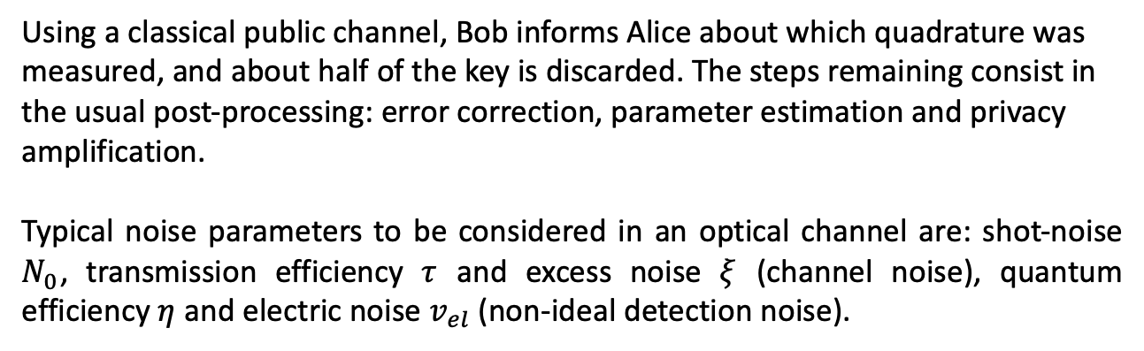
Continuous-Variable QKD
The simplest CV-QKD protocol that exploits coherent states is the GG02, and it resembles in some features the BB84 protocol: Alice prepares a finite number of coherent states, picking them from a complex Gaussian probability distribution with zero mean and variance V. The states are sent to Bob, which measures at random one of the quadratures with homodyne detection.
Using a classical public channel, Bob informs Alice about which quadrature was measured, and about half of the key is discarded. The steps remaining consist in the usual post-processing: error correction, parameter estimation and privacy amplification.
Typical noise parameters to be considered in an optical channel are: shot-noise $N_{0}$, transmission efficiency $τ$ and excess noise $ξ$ (channel noise), quantum efficiency $η$ and electric noise $v_{el}$ (non-ideal detection noise).

Slide 9
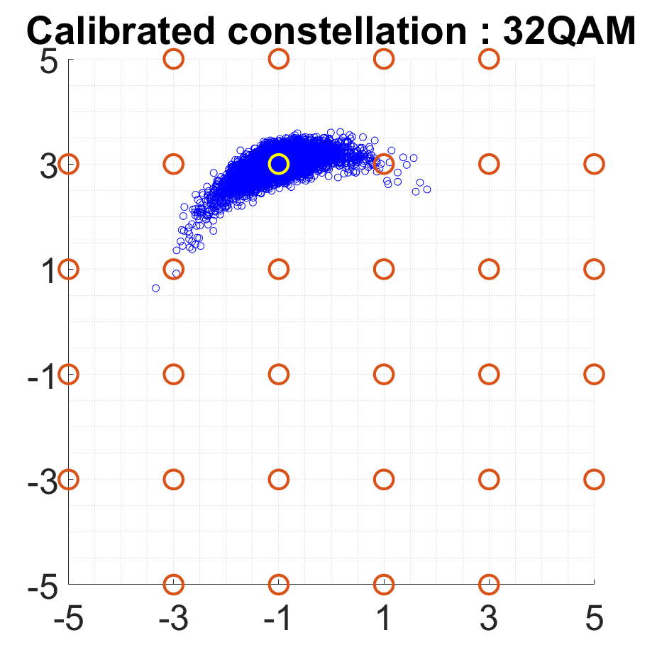
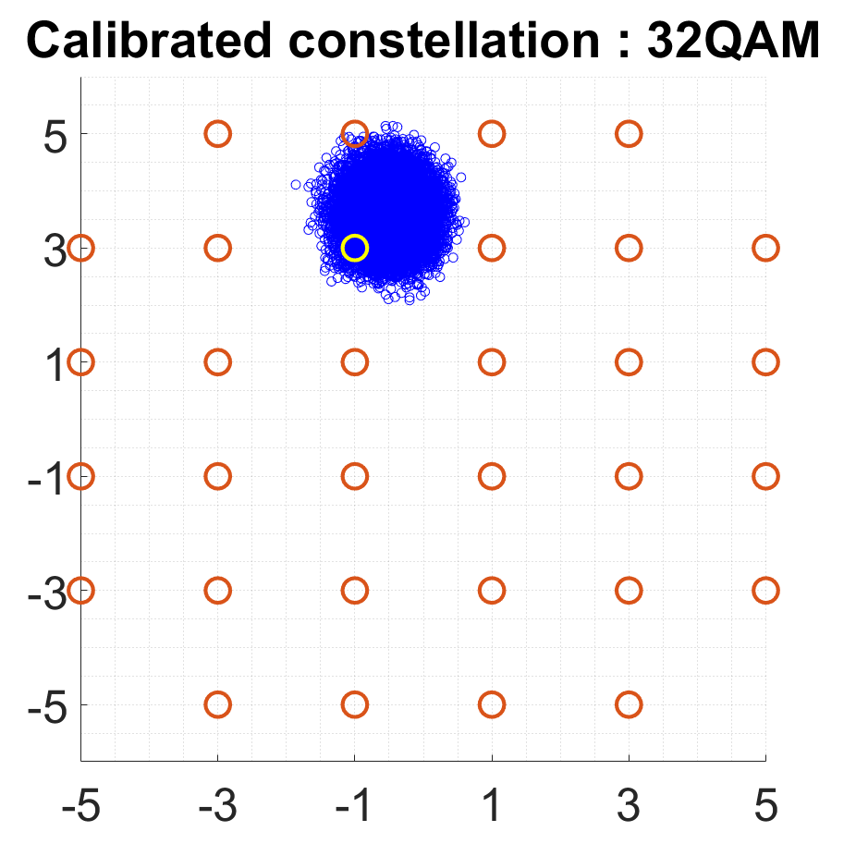
Simulation Parameters
We investigated the information rate of the GG02 protocol using QAM constellations with discrete gaussian input probability distribution, following the work of Roumestan et al.
Matched root raised cosine filter with span 16 symbols and roll off 0.2.
ITU G.602 fiber with D = 17 ps/(km nm) @1550 nm
Effects of phase noise and dispersion on received symbols in 32 QAM

Slide 10
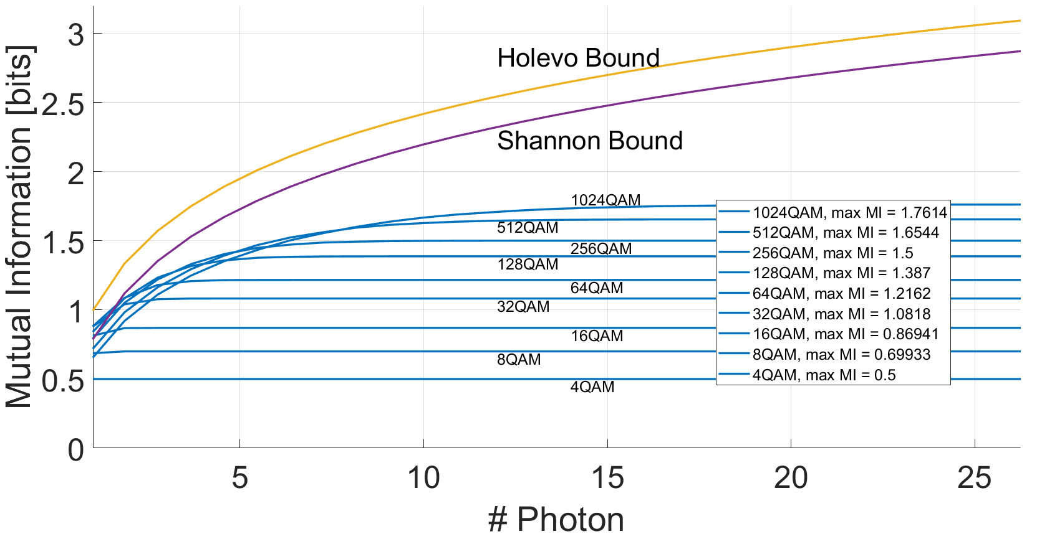
Quantum limited case
To approach these effects gradually, we begin our simulations considering propagation without dispersion, phase noise and attenuation, and an ideal detector without dark counts and electrical noise (τ = 1, η = 1, ξ = 0, ve = 0). The relevant effect that remains in this case is the quantum limited shot noise due to the Poissonian photocounting statistics:

Slide 11
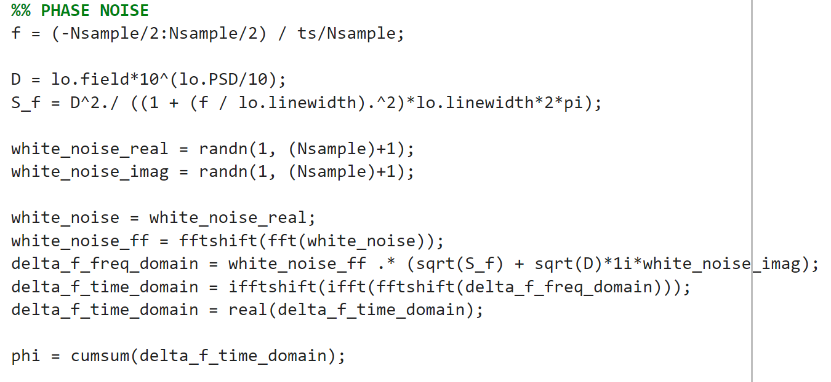
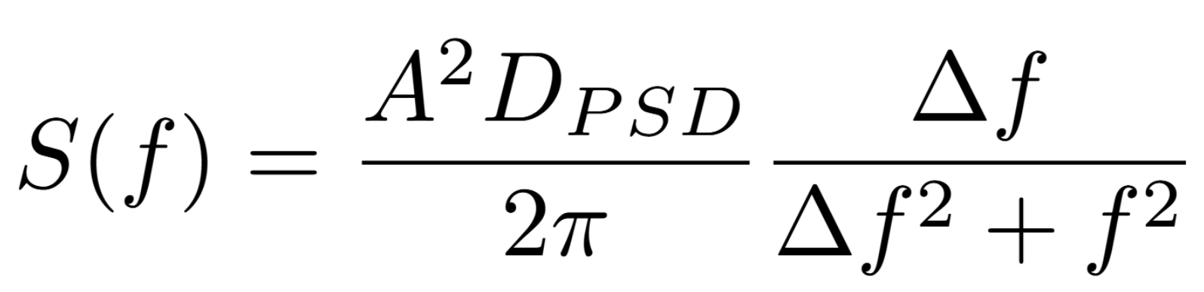
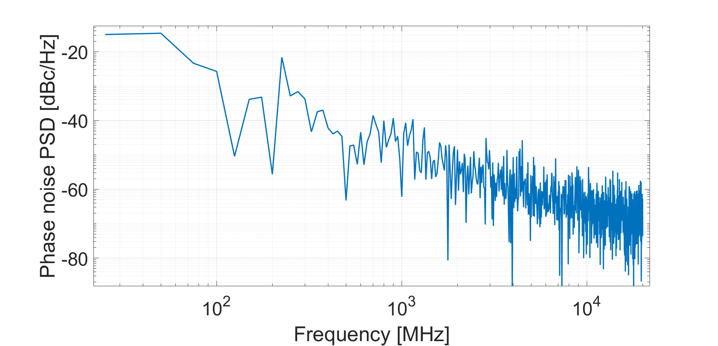
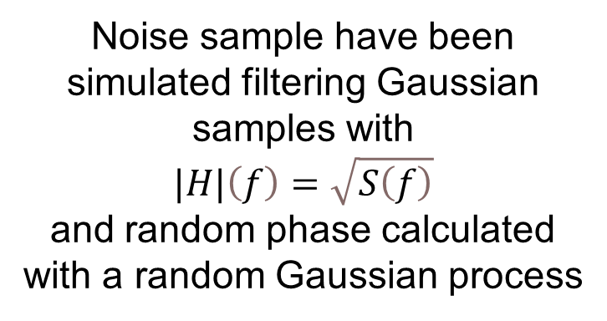
Phase Noise Simulation
Phase Noise has been modeled considering a Lorentzian PSD:
Noise sample have been simulated filtering Gaussian samples with
$$|H|\left(f\right)=\sqrt{S\left(f\right)}$$
and random phase calculated with a random Gaussian process

Slide 12
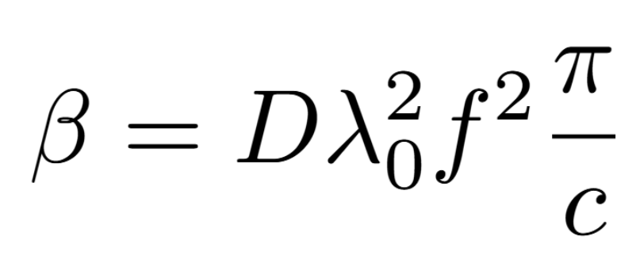
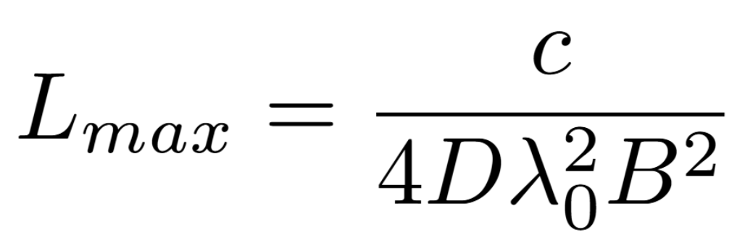
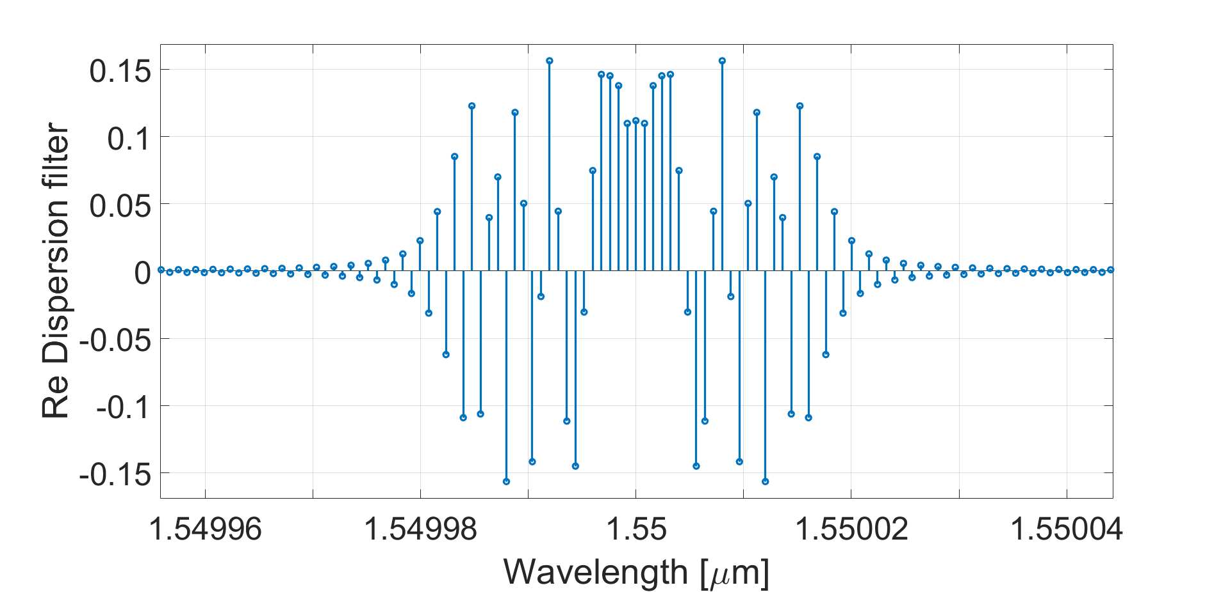
Dispersion Simulation
Only second order dispersion has been considered in our model
The length for which dispersion effects become significative has been approximated using the formula :

Slide 13
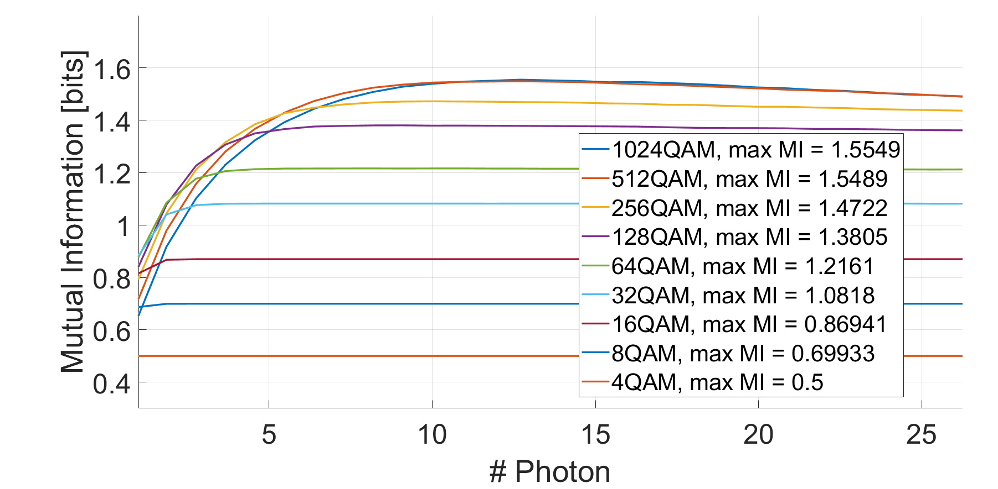
Phase noise at 1kHz and −80 dBc

Slide 14
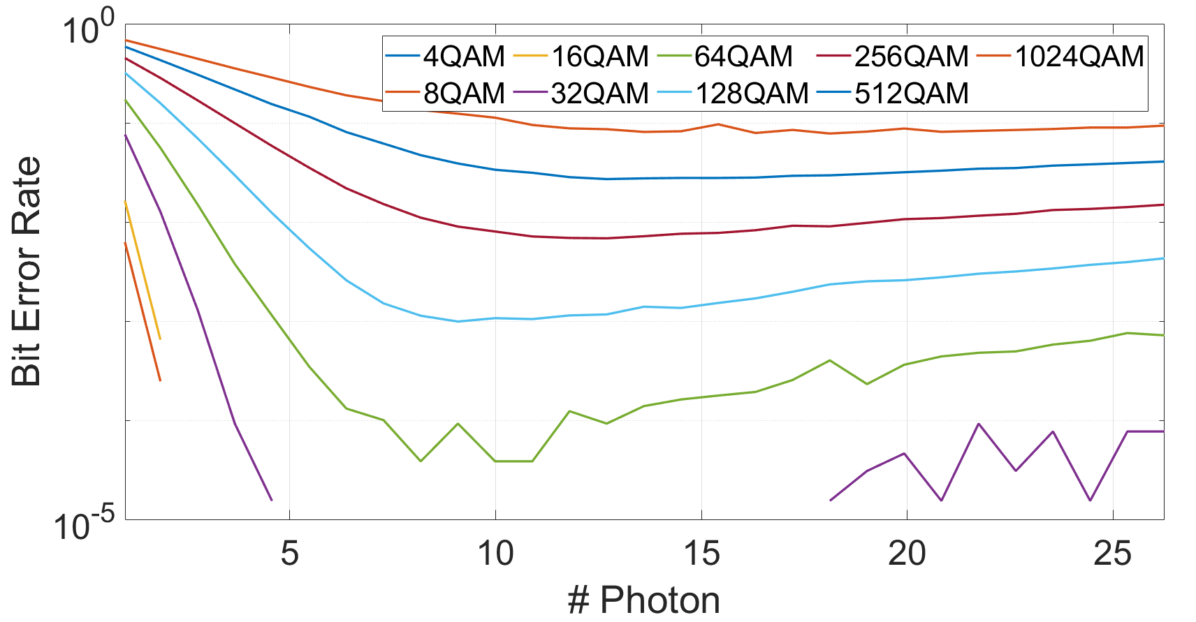
Phase noise at 1kHz and −80 dBc (QBER)

Slide 15
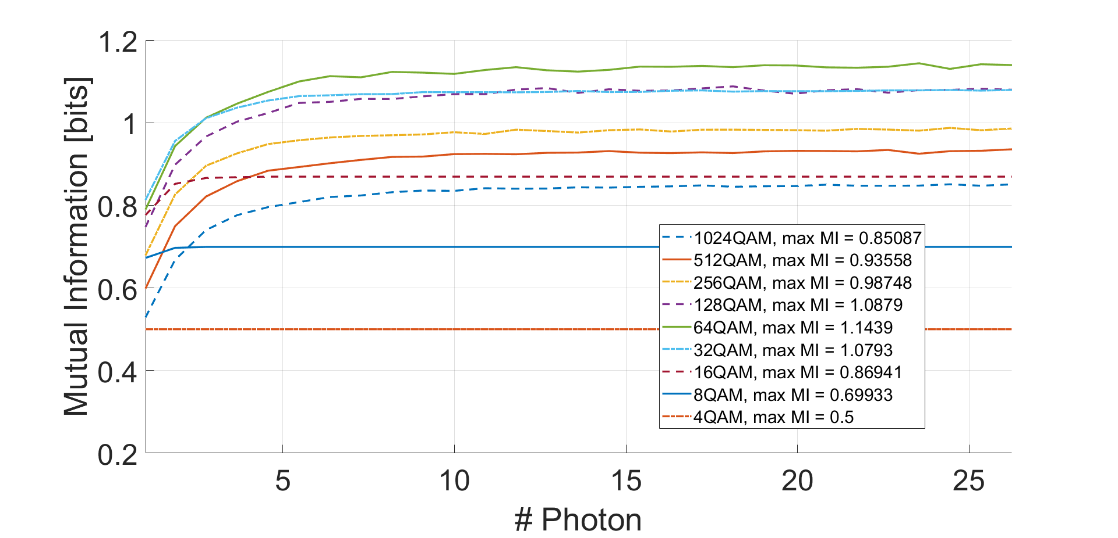
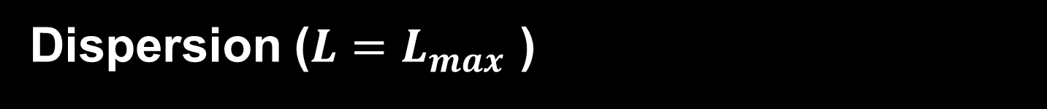
Dispersion ($L=L_{max}$ )

Slide 16
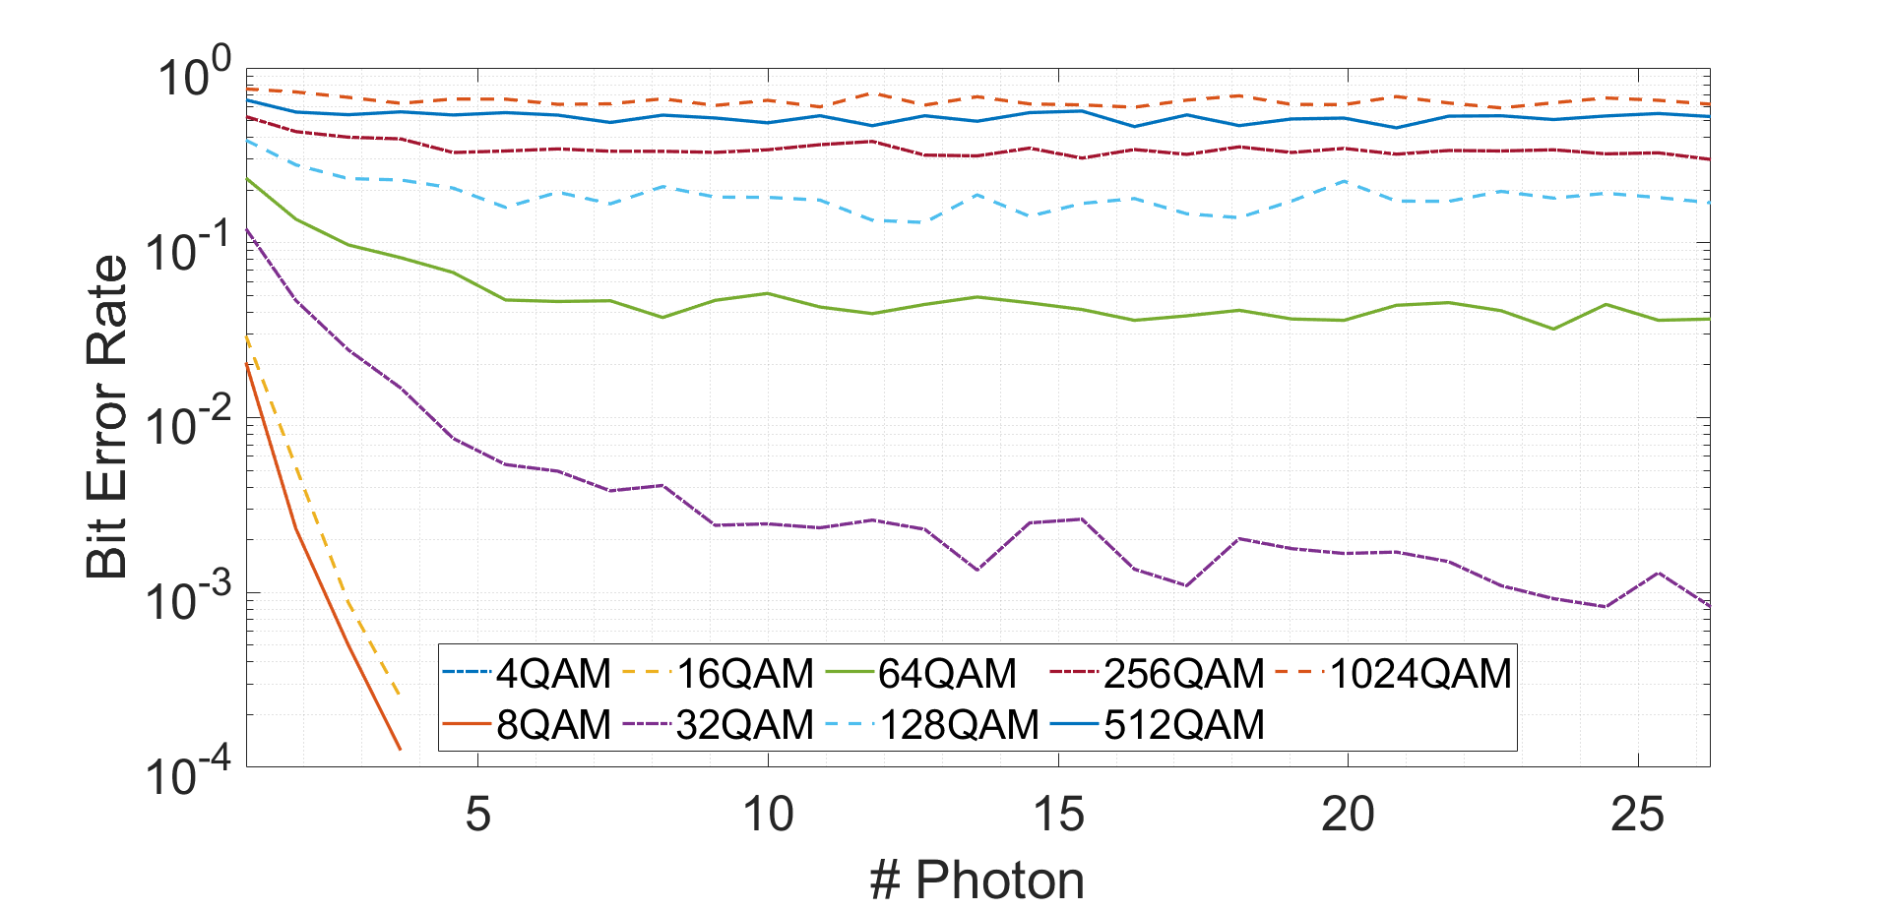
Dispersion ($L=L_{max}$ )

Slide 17
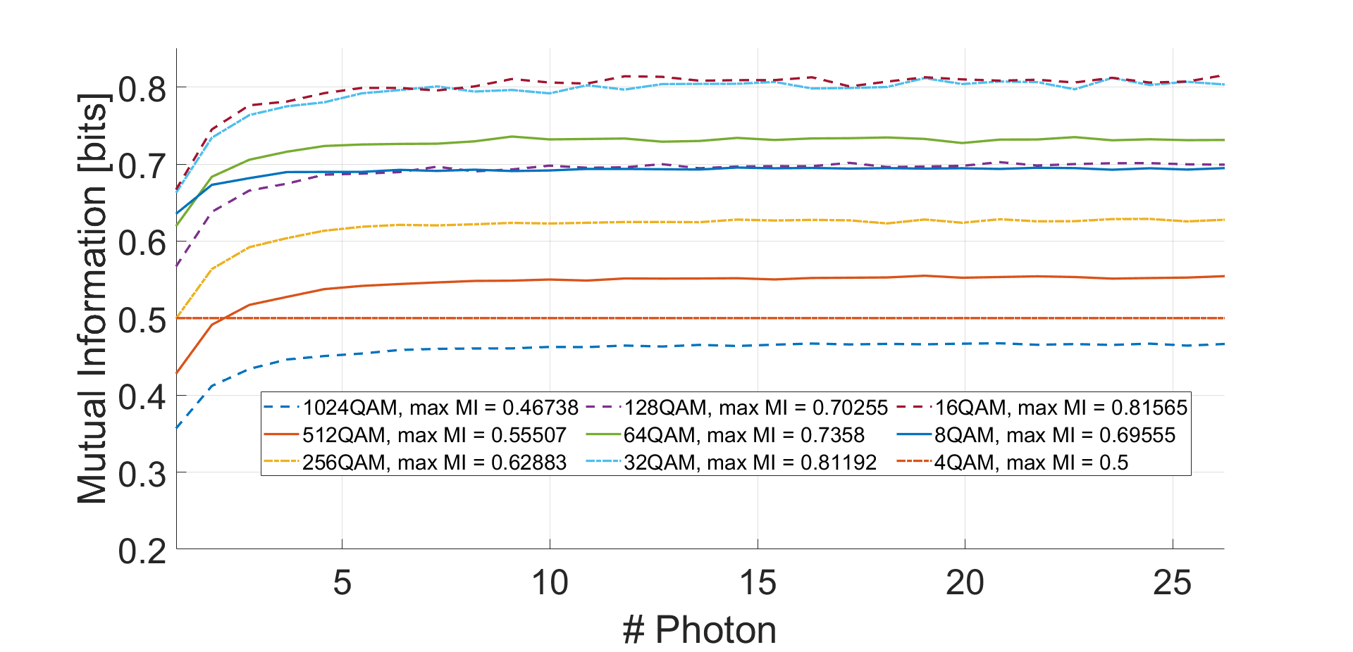
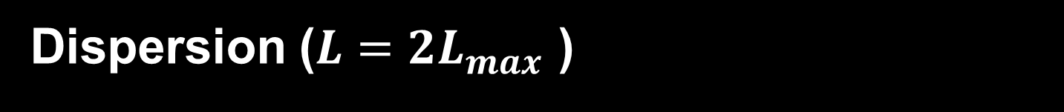
Dispersion ($L=2L_{max}$ )

Slide 18
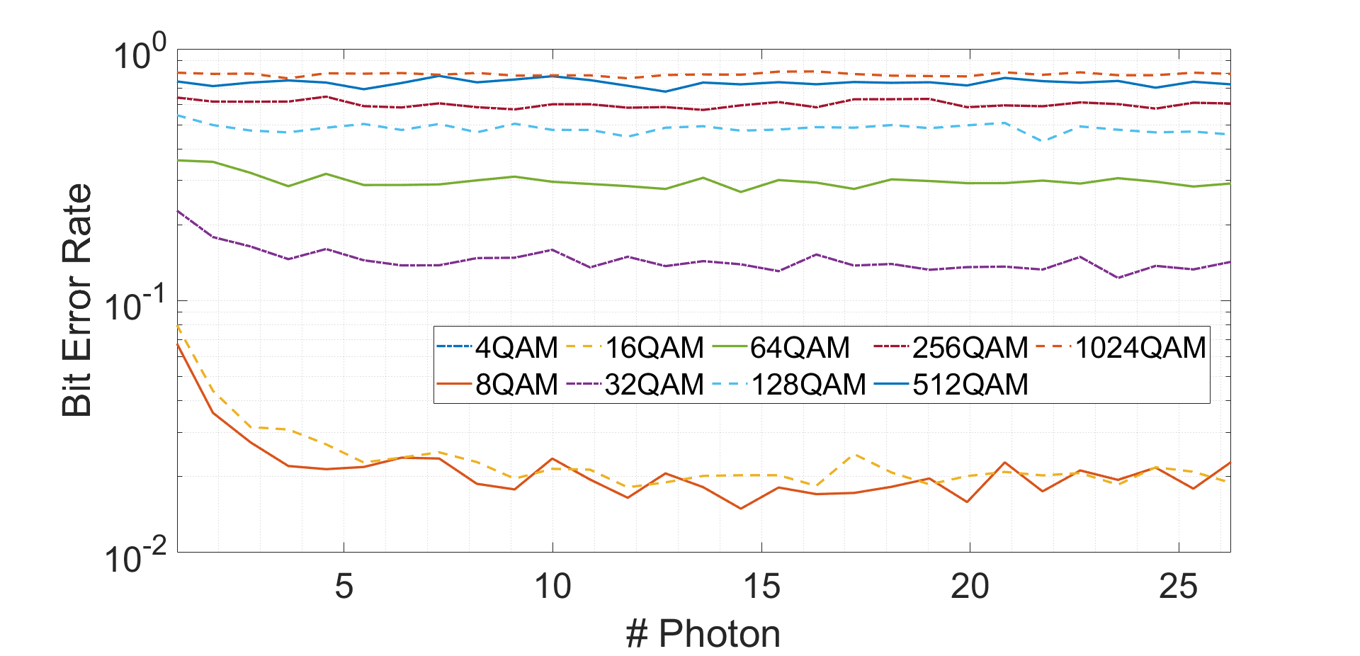
Dispersion ($L={2L}_{max}$ )

Slide 19
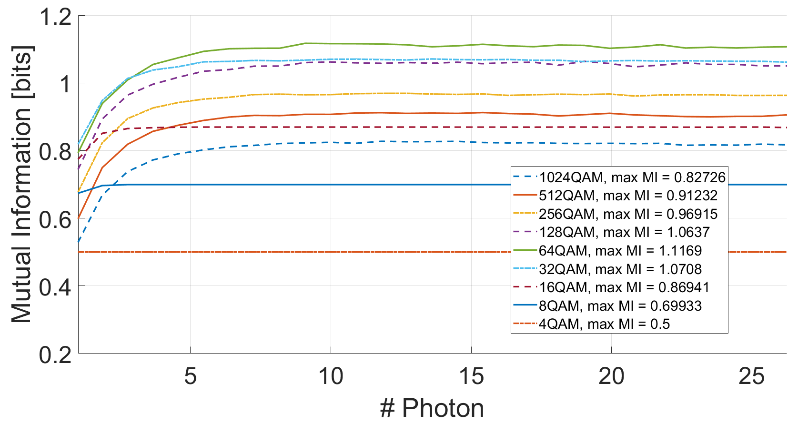
Combined effect of phase noise and dispersion

Slide 20
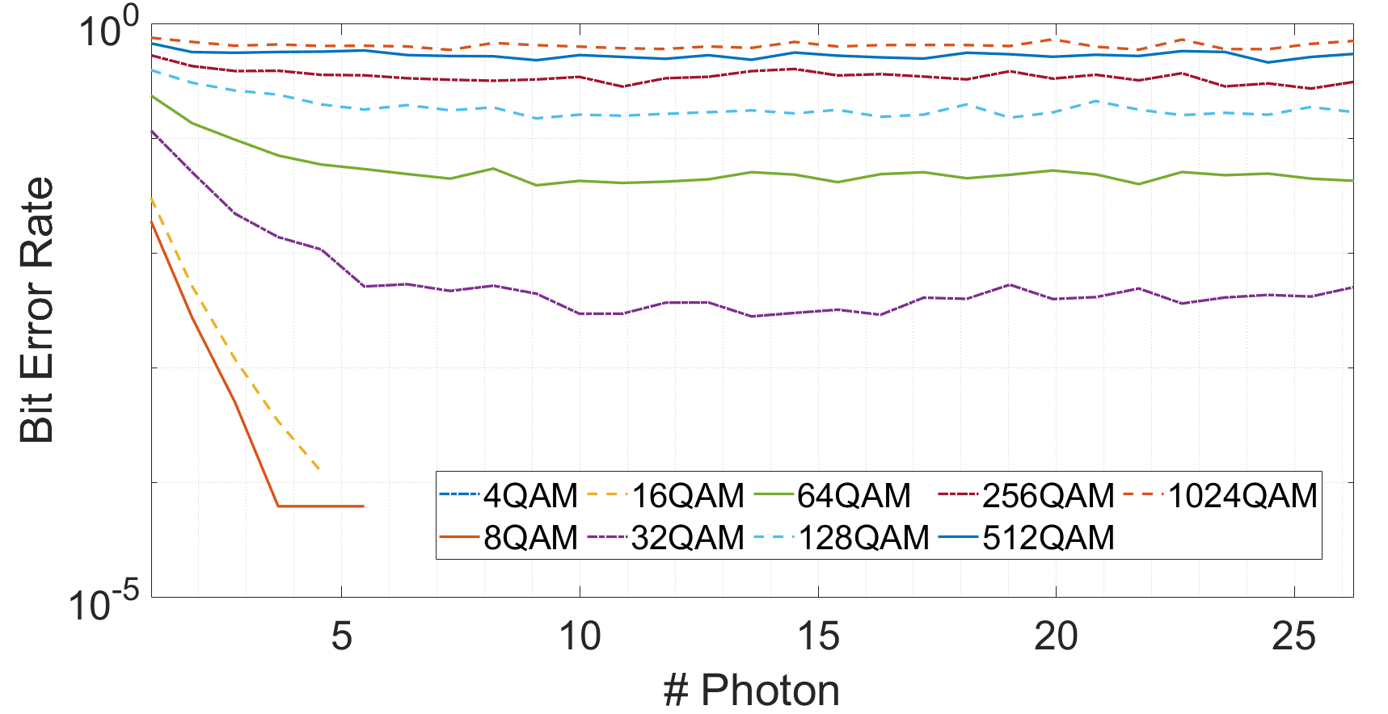
Combined effect of phase noise and dispersion

Slide 21
Capacity comparison
Comparison of the maximum mutual information of the QAM formats for the quantum limited case, only phase noise 1 kHz, −80 dBc case, only dispersion 17 ps / (km nm)
and L= Lmax case and dispersion and phase noise case. Highlighted in blue the maximum capacity for each column.

Slide 22
Titolo presentazione sottotitolo
THANK YOU FOR YOUR ATTENTION
Milano, XX mese 20XX
Gabriele Lecce, Roberto Scardia

